Slide 1
Moulded by the darkness: Grokking the TypeScript type system
Ivan Towlson
Microsoft

Slide 2
JavaScript The universal runtime

Slide 3
JavaScript The language for the universal runtime

Slide 4
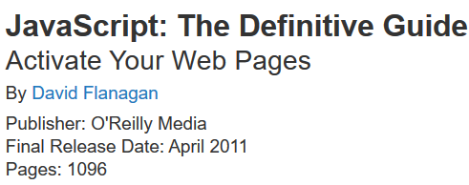
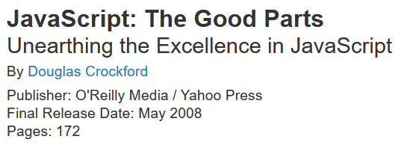
JavaScript The universally hated language for the universal runtime
Includes the appendix about the bad parts

Slide 5
JavaScript The assembly language for the universal runtime

Slide 6
ClojureScript
php.js
Script#
Fable
Java GWT
Scala.js
CoffeeScript
PureScript
JavaScript
Browser
Node.js
etc.

Slide 7
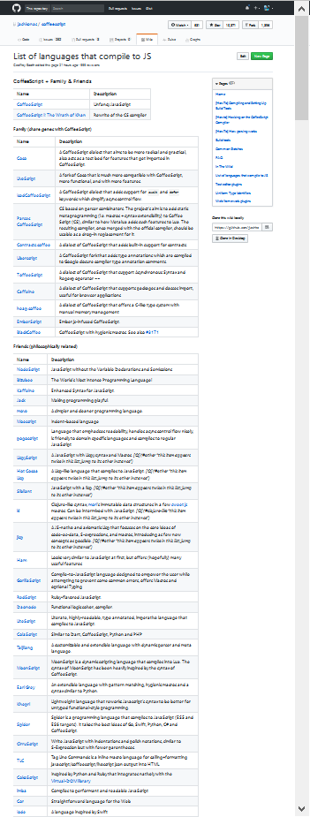
https://github.com/jashkenas/coffeescript/wiki/list-of-languages-that-compile-to-js
Screenshot at 30%

Slide 8
Thanks!
Ivan Towlson
Microsoft
https://github.com/itowlson/typed-darkness
http://twitter.com/ppog_penguin
http://hestia.typepad.com/flatlander
itowlson@microsoft.com
ivan@hestia.cc

